Slide 1
poInter ve array

Slide 2
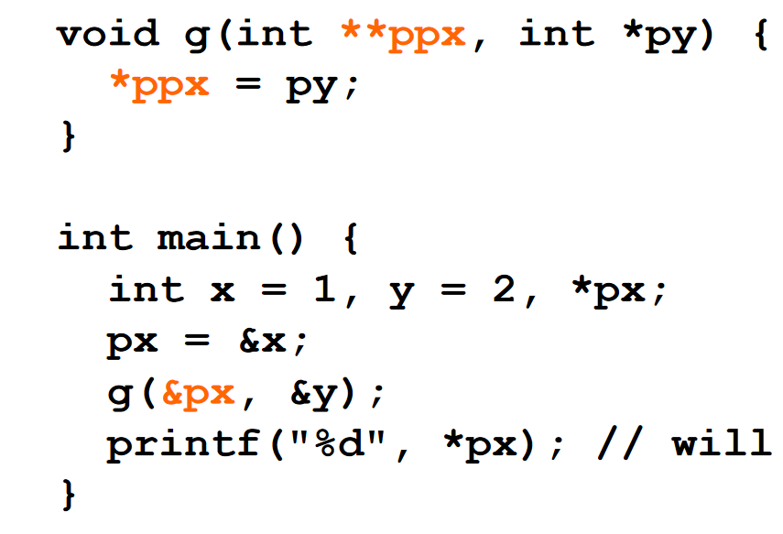

Slide 3
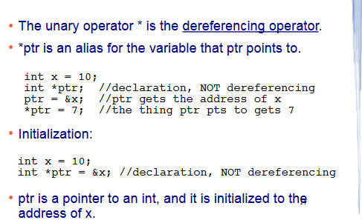

Slide 4
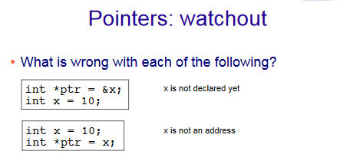

Slide 5
Arrays
An Array is a collection of variables of the same type that are referred to through a common name.
Declaration
  type var_name[size]
  e.g
int A[6];
double d[15];

Slide 6
Array Initialization
After declaration, array contains some garbage value.
Static initialization
Run time initialization
int month_days[] = {31, 28, 31, 30, 31, 30, 31, 31, 30, 31, 30, 31};
int i;
int A[6];
for(i = 0; i < 6; i++)
A[i] = 6 - i;

Slide 7
Memory addresses
0A | 0x00001234
23 | 0x00001235
6C | 0x00001236
1D | 0x00001237
‘W’ | 0x00001238
‘o’ | 0x00001239
‘w’ | 0x0000123A
‘\0’ | 0x0000123B
. | .
. | .
. | .
 | 0x24680975
 | 0x24680976
 | 0x24680977
 | 0x24680978
Memory is divided up into one byte pieces individually addressed.
- minimum data you can request from the memory is 1 byte
Each byte has an address.
for a 32 bit processor, addressable memory is 2³² bytes. To uniquely identify each of the accessible byte you need log₂2³² = 32 bits

Slide 8
Array - Accessing an element
A[0] | A[1] | A[2] | A[3] | A[4] | A[5]
0x1000 | 0x1004 | 0x1008 | 0x1012 | 0x1016 | 0x1020
6 | 5 | 4 | 3 | 2 | 1
int A[6];
6 elements of 4 bytes each,
total size = 6 x 4 bytes = 24 bytes
Read an element
Write to an element
{program: array_average.c}
int tmp = A[2];
A[3] = 5;

Slide 9
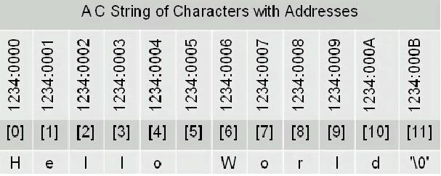
Strings in C
No “Strings” keyword
A string is an array of characters.
OR
char string[] = “hello world”;
char *string = “hello world”;

Slide 10
Significance of NULL character ‘\0’
char string[] = “hello world”;
printf(“%s”, string);
Compiler has to know where the string ends
‘\0’ denotes the end of string
{program: hello.c}

Slide 11
Pointers in C
A char pointer points to a single byte.
An int pointer points to first of the four bytes.
A pointer itself has an address where it is stored in the memory. Pointers are usually four bytes.
* is called the dereference operator
*p gives the value pointed by p
4 i
p
& (ampersand) is called the reference operator
&i returns the address of variable i
int *p; ⬄ int* p;
int i = 4;
p = &i;

Slide 12
More about pointers
int x = 1, y = 2, z[10];
int *ip; /* A pointer to an int */
ip = &x; /* Address of x */
y = *ip; /* Content of ip */
*ip = 0; /* Clear where ip points */
ip = &z[0]; /* Address of first element
of z */
{program: pointer.c}

Slide 13
#include <stdio.h>
#define PRPTR(p) printf("%p\n", p)
#define deger(z) printf("%d\n", z)
int main()
{
int nums[] = {10,20,30,40,50,60,70,80};
int *a = nums;
int *b = a ;
printf("sizeof(int) = %d\n", sizeof(int));
PRPTR(a + 0);
PRPTR(a + 1);
PRPTR(b + 2);
deger (*(b)+2);
PRPTR(b - 1);
return 0;
}

Slide 14
#include <stdio.h>
void getSumAndMean(float * fvals, int size, float* s, float* m);
int main()
{
int i, N;
float *arr;
float sum=0, mean=0;
printf("How many elements? ");
scanf("%d",&N);
arr = (float*)malloc(sizeof(float)*N);
printf("Input %d float values.\n",N);
for (i=0;i<N;i++) {
scanf("%f",&arr[i]);
}
getSumAndMean(arr, N, &sum, &mean);
printf("sum=%f , mean=%f\n",sum,mean);
free(arr);
return 0;
}
void getSumAndMean( float * fvals, int size, float* s, float* m)
{
float sum=0;
int i;
for (i=0;i<size;i++) { sum+=fvals[i];}
*s=sum;
*m=*s/size;
}

Slide 15
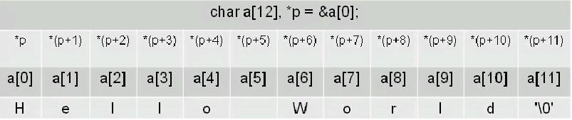
Pointers and arrays
Pointers and arrays are tightly coupled.
char a[] = “Hello World”;
char *p = &a[0];

Slide 16
String input
Example1)
  char *name;
  scanf("%s", name);
Example2)
  char name[81];
  scanf("%s", name);
Example3)
  char *name;
  name=(char*)malloc(sizeof(char)*81);
  scanf("%s", name);
  …
  free(name); // deallocate when name is no longer useful

Slide 17
#include <stdio.h>
int main()
{
char metin[] = "Ara sinava az kaldi...";
char *p = metin;
int i;
putchar(*(p+1));
for (i=0; i<strlen(metin); i++) putchar(*(p+i));
for (i=0; i<strlen(metin); i++) putchar(p[i]);
}

Slide 18
Example Code
int x = 1, y = 2, z[10];
int *ip; // ip is a pointer to an int, so it can point to x, y, or an element of z
ip = &x; // ip now points at the location where x is stored
y = *ip; // set y equal to the value pointed to by ip, or y = x
*ip = 0; // now change the value that ip points to to 0, so now x = 0
// but notice that y is unchanged
ip = &z[0]; // now ip points at the first location in the array z
*ip = *ip + 1; // the value that ip points to (z[0]) is incremented
int x, *y, z, *q;
x = 3;
y = &x; // y points to x
printf("%d\n", x); // outputs 3
printf("%d\n", y); // outputs x’s address, will seem like a random number to us
printf("%d\n", *y); // outputs what y points to, or x (3)
printf("%d\n", *y+1); // outputs 4 (print out what y points to + 1)
printf("%d\n", *(y+1)); // this outputs the item after x in memory – what is it?
z = *(&x); // z equals 3 (what &x points to, which is x)
q = &*y; // q points to 3 – note *& and &* cancel out
Notes:
What happens when you try to dereference p+1? That is, int *p = &x; followed by *(p+1) ???
It depends on what is stored next in memory. The location (p+1) is not 1 byte + the location of p, but instead byte p + n where n is the size of the datum that p points to (4 bytes for an int or a float, 8 bytes for a double or long, 1 byte for char, 2 bytes for a short). Lets consider the following code:
int x=1, y=10, z=100;
int *p = &x; // p now points at x
printf(“%d %d %d\n”, *p, *(p+1), *(p+2));
This will probably about 1 10 100. Why? The compiler will usually place local variables in contiguous blocks of memory. So *p points at x but *(p+1) will probably point at y (but not definitely) and *(p+2) will point at z. So notice that *(p+2) is perfectly legal syntactically and may execute without error. If you are wrong with this assumption, or careless, then you will get a run-time error because you have tried to dereference an area of memory that is either not your own, or not a variable (it is possible that you are dereferencing code, which is not legal).

Slide 19
Arrays and Pointers
We declare an array using [ ] in our declaration following the variable name
  int x[5]; You must include the size of the array in the [ ] when declaring unless you are also initializing the array to its starting values as in:
  int x [ ] = {1, 2, 3, 4, 5};
  you can also include the size when initializing as long as the size is >= the number of items being initialized (in which case the remaining array elements are uninitialized)
Arrays in C are interesting because they are pointed to
  the variable that you declare for the array is actually a pointer to the first array element
You can interact with the array elements either through pointers or by using [ ]
One of the intriguing features of pointers in C is the ability to manipulate the pointers through pointer arithmetic – a pointer is an int value, so we can add or subtract
  this will be used for stepping through arrays rather than using array indices

Slide 20
Iterating Through the Array
Here we see two ways to iterate through an array, the usual way, but also a method using pointer arithmetic
int j;
for(j = 0; j < n; j++)
a[j]++;
int *pj;
for(pj = a; pj < a + n; pj++)
(*pj)++;
Let’s consider the code on the right:
  pj is a pointer to an int
  We start with pj pointing at a, that is, pj points to a[0]
  The loop iterates while pj < a + n
    pj is a pointer, so it is an address
    a is a pointer to the beginning of an array of n elements so a + n is the size of the array
    pj++ increments the pointer to point at the next element in the array
    The instruction (*pj)++ says “take what pj points to and increment it”
  NOTE: (*pj)++; increments what pj points to, *(pj++); increments the pointer to point at the next array element
    what do each of these do? *pj++; ++*pj;
Notes:
Do the following:
int a[ ] = {1, 5};
int *p = a;
printf(“%d\n”, *p++);
printf(“%d\n”, *p);
p = a;
printf(“%d\n”, *++p);
printf(“%d\n”, *p);
p = a;
printf(“%d\n”, ++*p);
printf(“%d\n”, *p);
And see what you get. Which of these increment p vs increment *p? *p++, ++*p, *++p??? Using *p++ is dangerous unless you are clear in what you are doing.

Slide 21
Array Example Using a Pointer
int x[4] = {12, 20, 39, 43}, *y;
y = &x[0]; // y points to the beginning of the array
printf("%d\n", x[0]); // outputs 12
printf("%d\n", *y); // also outputs 12
printf("%d\n", *y+1); // outputs 13 (12 + 1)
printf("%d\n", (*y)+1); // also outputs 13
printf("%d\n", *(y+1)); // outputs x[1] or 20
y+=2; // y now points to x[2]
printf("%d\n", *y); // prints out 39
*y = 38; // changes x[2] to 38
printf("%d\n", *y-1); // prints out x[2] - 1 or 37
*y++; // sets y to point at the next array element
printf("%d\n", *y); // outputs x[3] (43)
(*y)++; // sets what y points to to be 1 greater
printf("%d\n", *y); // outputs the new value of x[3] (44)

Slide 22
Strings
There is no string type, we implement strings as arrays of chars
  char str[10]; // str is an array of 10 chars or a string
  char *str; // str points to the beginning of a string of unspecified length
There is a string.h library with numerous string functions
  they all operate on arrays of chars and include:
    strcpy(s1, s2) – copies s2 into s1 (including ‘\0’ as last char)
    strncpy(s1, s2, n) – same but only copies up to n chars of s2
    strcmp(s1, s2) – returns a negative int if s1 < s2, 0 if s1 = = s2 and a positive int if s1 > s2
    strncmp(s1, s2, n) – same but only compares up to n chars
    strcat(s1, s2) – concatenates s2 onto s1 (this changes s1, but not s2)
    strncat(s1, s2, n) – same but only concatenates up to n chars
    strlen(s1) – returns the integer length of s1
    strchr(s1, ch) – return a pointer to the first occurrence of ch in s1 (or NULL if ch is not present)
    strrchr(s1, ch) – same but the pointer points to the last occurrence of ch
    strpbrk(s1, s2) – return a pointer to the first occurrence of any character in s1 that matches a character in s2 (or NULL if none are present)
    strstr(s1, s2) – substring, return a pointer to the char in s1 that starts a substring that matches s2, or NULL if the substring is not present
Notes:
NOTE: if you do char *string, then string is a pointer variable that currently is not pointing anywhere. If you were to do
string=“hello”; or
char(“%s”, string);
You would have a run-time error because string does not have allocated memory (yet). You could, however, do this:
char s[10];
…
string = s;
The variable string is merely a pointer whereas s is an array. string, prior to doing string=s had nothing to point to and therefore could not be operated upon. s on the other hand was allocated memory when s was created.
We learn how to allocate memory for strings in C chapter 6 by using calloc. For now, just use arrays to declare strings.

Slide 23
More On Pointer Arithmetic
We can also perform subtraction on pointers
Here, we pass to a function the address of the third element of an array (&a[2]) and use pointer subtraction to get to a[0] and a[1])
int a[10] = {…};
int *ip;
for(ip = &a[9]; ip >= a; ip--)
…
int addem(int *ip)
{
int temp;
temp = *ip + *(ip – 1) + *(ip – 2);
return temp;
}
int a[3] = {…};
printf(“%d”, addem(&a[2]));
Recall:
a[0] = *a and
a[i] = *(a + i)
If a is an array, and p = &a[0] then we can reference array
elements as a[i], *(p+i), but we can also reference them as
p[i] and *(a+i) – that is, a and p are both pointers to the array
And can be dereferenced by * or by [ ]

Slide 24
Multidimensional Arrays
As in Java, C allows multidimensional arrays by using more [ ]
  Example: int matrix[5][10];
Some differences:
  Because functions can be compiled separately, we must denote all but one dimension of a multiple dimensional array in a function’s parameter list
    void afunction(int amatrix[ ][10]);
  Because arrays are referenced through pointers, there are multiple ways to declare and access 2+ dimensional arrays
    This will be more relevant when dealing with an array of strings (which is a 2-D array)
int a[10][20];
int *a[10];
int **a;
int *a[3]; // array of 3 pointers
int x[2] = {1, 2};
int y[3] = {3, 4, 5};
int z[4] = {6, 7, 8, 9};
*a = &x[0]; // a[0] points to x[0]
*(a+1) = &y[0]; // a[1] points to y[0]
*(a+2) = &z[0]; // a[2] points to z[0]
// array a is a jagged array, it is not
// rectangular, or of equal dimensions
*a[4] –first element of 5th array element
*a[9] –first element of 10th array element
**a –first element of a[0]
Notes:
We discuss mapping functions in CSC 507, but here is a bit of information. The compiler sets up a mapping function so that the array access
a[i] or b[i][j]
Can be translated into a memory location. This makes array accesses efficient. Without a mapping function, the actual memory location for an array reference like b[i][j] would have to be determined at run-time.
Usually, computing a mapping function is straight-forward for a compiler. But because a C function might be in a file that does not include the array’s declaration, the compiler still must know what the array’s dimensions are to set up the mapping function. The only dimension not necessary is the number of rows (the first dimension). Therefore, the following are required in either a prototype that defines a function, or in the array’s header:
int a[ ] // one dimension, no other values needed
int b[ ][10] // two dimensions, number of rows not needed
int c[ ][10][20][30] // four dimensions, number of rows not needed

Slide 25
Multiple String
Using 2 dimensional array
  char colors[3][10]= {"red", "blue", "white"};
or
char *colorp[3] = {"red", "blue", "white"};

Slide 26
Multiple String
colors[0]
colors[1]
colors[2]
r e d \0
b l u e \0
w h i t e \0
r e d \0
colorp[0]
colorp[1]
colorp[2]
b l u e \0
w h i t e \0

Slide 27
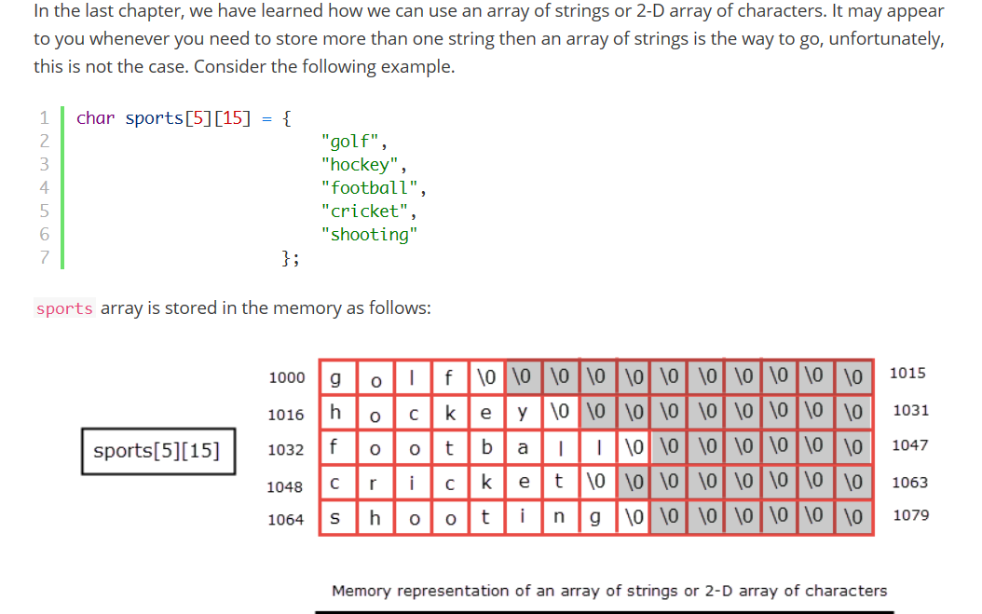

Slide 28
String Input/Output
char *gets(char *str);
  Read one line string from keyboard
  Put the input string into str
int puts(char *str);
  Print string str into standard output

Slide 29
Pointers to Pointers
As indicated in the last slide, we can have an array of arrays which is really an array of pointers or pointers to pointers
  We may wish to use pointers to pointers outside of arrays as well, although it is more common that pointers to pointers represent array of pointers
  Consider the following:
int a;
int *p;
int **q;
a = 10;
p = &a;
q = &p;
printf(“%d”, **q); // outputs 10
We dereference our pointer p with *p but we dereference
our pointer to a pointer q with **q
*q is actually p, so **q is a

Slide 30
#include <stdio.h>
int main()
{
char month[12][10]={
"January", "February", "March", "April",
"May", "June", "July", "August",
"September", "October", "November", "December"};
char str[100];
int m;
printf("Input Month : ");
scanf("%d",&m);
if (m>=1 && m<=12) printf("Text : %s\n",month[m-1]);
else printf("Illegal Month\n");
return 0;
}

Slide 31
Arrays of Strings Implementation
We could implement an array of strings as a 2-D array of chars
  char array[10][10];
This has two disadvantages
  All strings will be 10 chars long
  Requires 2 nested for-loops for most operations such as string comparison or string copying, which can become complicated
Instead, we will implement our array of strings as an array of pointers
  char *array[10];
Each pointer points to one string
  Follow the string through the pointer
  Go to the next string using a for-loop
  Because strcpy, strcmp, strlen all expect pointers, we can use these by passing an array element (since each array element is a pointer to a string)

Slide 32
Example
char *x[ ] = {"hello", "goodbye", "so long", "thanks for all the fish"};
// our array of strings x is a set of 4 pointers
char *y; // let y be a pointer to a char so it can be used to move through a single string
int i;
for(i=0;i<4;i++) // iterate for each string in x
{
y = x[i]; // x[i] is an array, x is really a pointer, so this sets y to x’s starting addr.
while(*y!='\0') // while the thing y points to is not the end of a string
{
printf("%c", *y); // print what y points to
y++; // and go on to the next char in x
}
printf("\n"); // separate strings in output with \n
}
Notice that if we had used char x[ ][ ] = {…}; then the storage space would have been 4 strings of length 23 (the length of the longest string) or 92 bytes instead of 42 bytes as it is above

Slide 33
Passing Arrays
When an array is passed to a function, what is being passed is a pointer to the array
  In the formal parameter list, you can either specify the parameter as an array or a pointer
Because you can compile functions separately, the compiler must be able to “know” about an array being passed in to a function, so you must specify all (or most) of the definition:
  The type and all dimensions except for the first
int array[100];
…
afunction(array);
…
void afunction(int *a) {…}
or
void afunction(int a[ ]) {…}
int array[5][10][15];
…
afunction(array);
…
void afunction(int a[ ][10][15]) {…} or
void afunction(int *a[10][15]) {…} or
void afunction(int a[5][10][15]) {…} or
void afunction(int **a[15]) {…} etc
Notes:
The reason that the compiler must “know” about the array dimensions is to set up a mapping function. A mapping function is generated by the compiler so that, at run time, the operation a[i][j] can be converted into a memory location access easily. The mapping function for an array of N rows and M columns looks like this in C:
a[i][j] = OFFSET + i * M + j
Where OFFSET is the starting location for a. See if you can figure out why the formula is as it is. But notice that while we need to know M (number of columns), we don’t need N (number of rows). Therefore, when you pass the array to a function, you must specify the number of columns but not the number of rows.
We study this in more detail in CSC 507.

Slide 34
Some Additional Comments
In functions, do not do return p; where p is a pointer
  Recall local variables are deallocated when the function ends
    so whatever p is pointing to will no longer be available
    but if you return the pointer, then you still are pointing at that memory location even though you no longer know what is there
We can declare a pointer to point to a void type, which means that the pointer can point to any type
  However, this does require a cast before the pointer can be assigned
    int x; float y; void *p; // p can point to either x or y
    p = (int *) &x; // p can point to int x once the address is cast
    p = (float *) &y; // or p can point to float y
Pointers that don’t currently point to anything have the special value NULL and can be tested as (p = = NULL) or (!p), and (p != NULL) or (p)

Slide 35
2-Dimensional Arrays (Array of arrays)
int d[3][2];
Access the point 1, 2 of the array:
d[1][2]
Initialize (without loops):
int d[3][2] = {{1, 2}, {4, 5}, {7, 8}};

Slide 36
More about 2-Dimensional arrays
A Multidimensional array is stored in a row major format.
A two dimensional case:
➔ next memory element to d[0][3] is d[1][0]
d[0][0] | d[0][1] | d[0][2] | d[0][3]
d[1][0] | d[1][1] | d[1][2] | d[1][3]
d[2][0] | d[2][1] | d[2][2] | d[2][3]
What about memory addresses sequence of a three dimensional array?
➔ next memory element to t[0][0][0] is t[0][0][1]

Slide 37
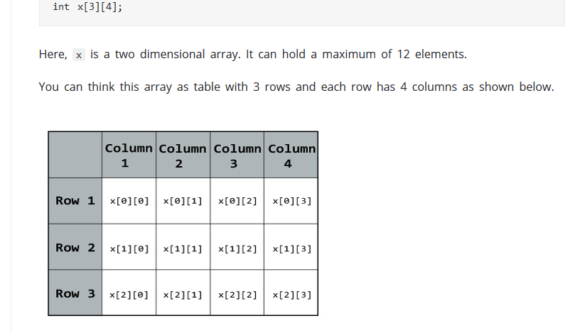

Slide 38
